Slide 1

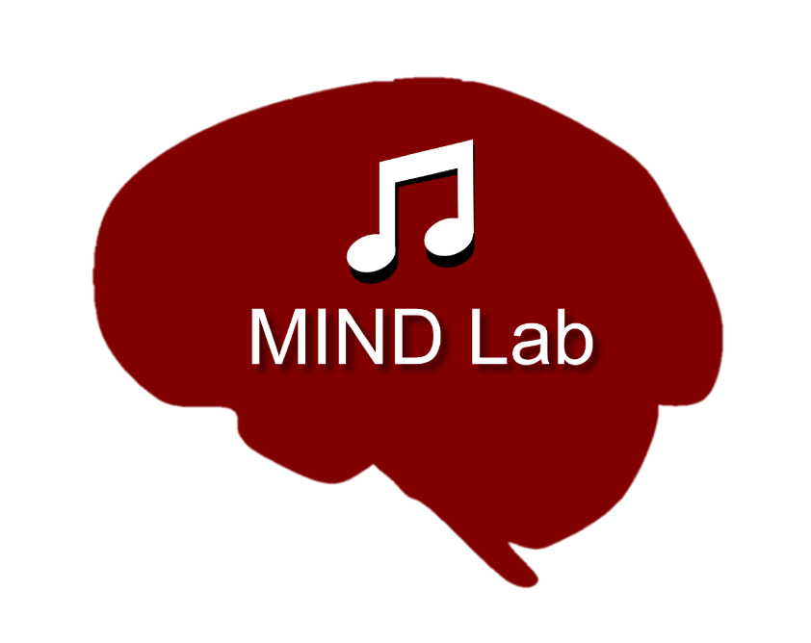

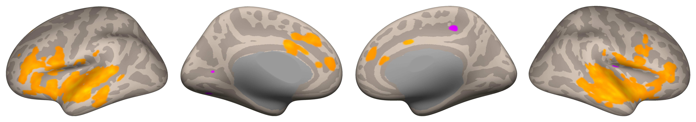
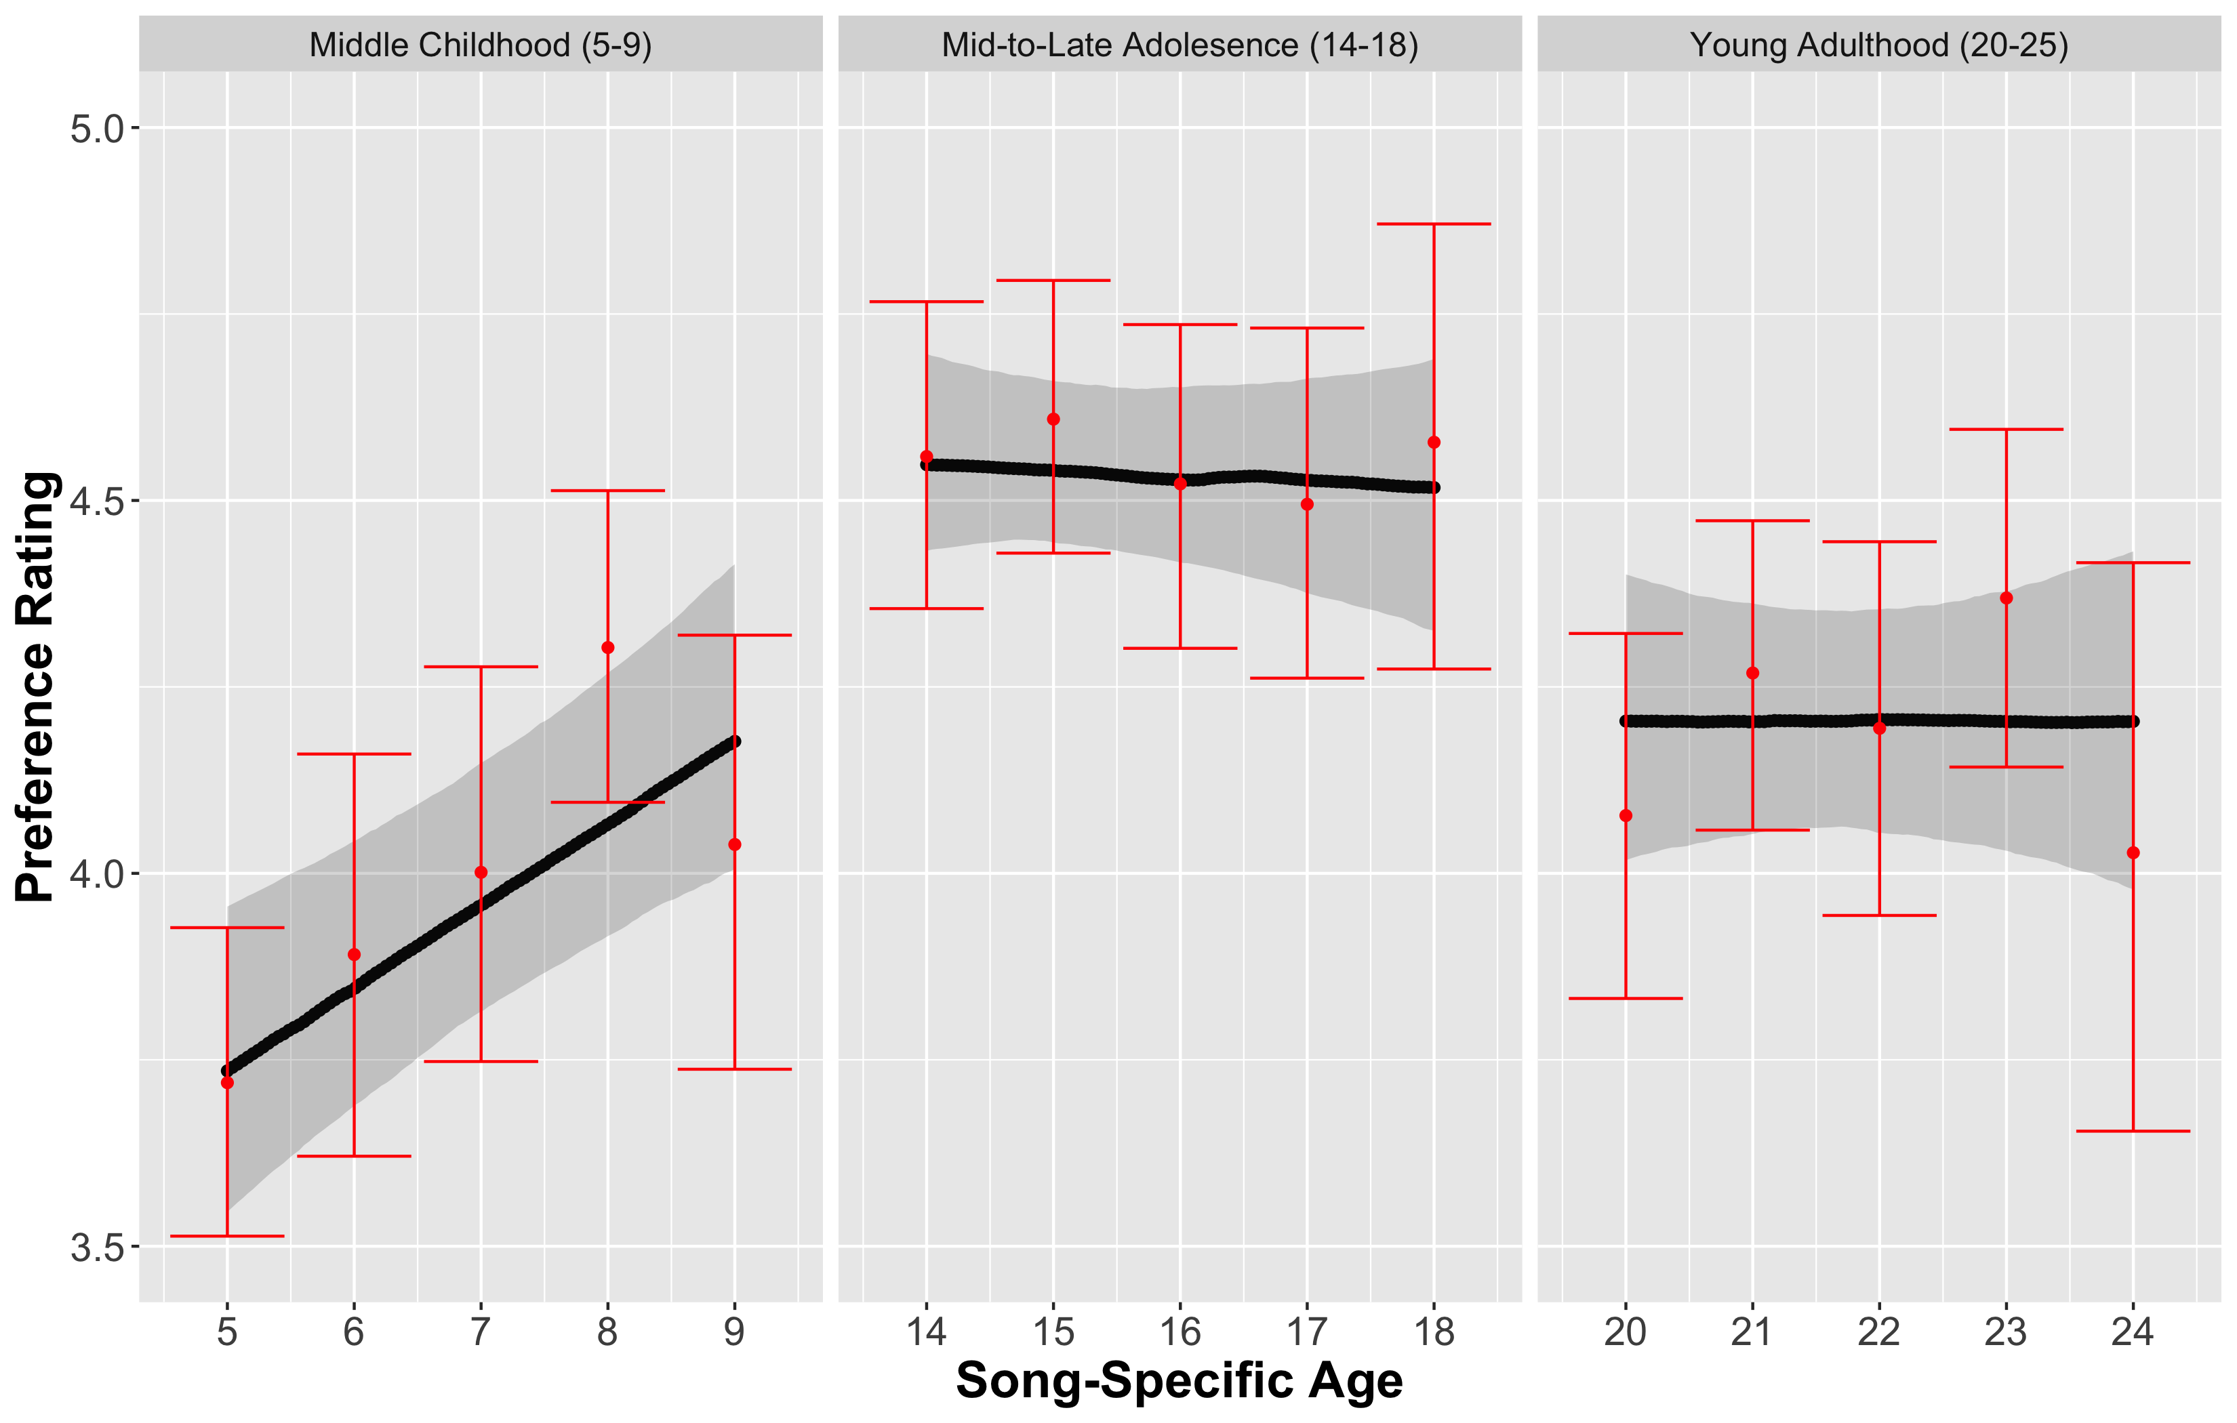
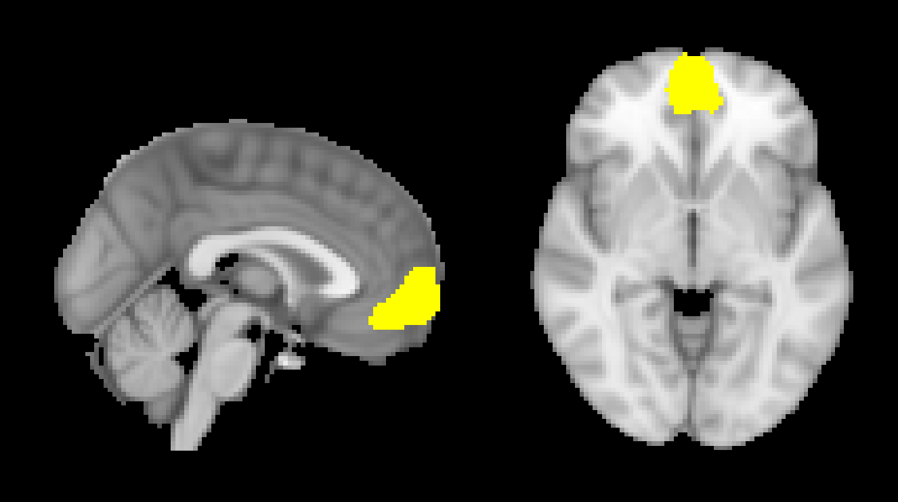
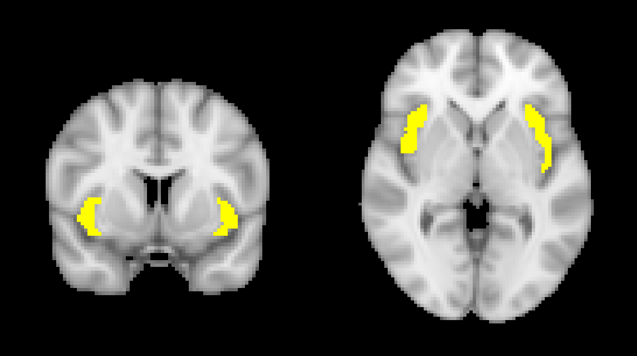
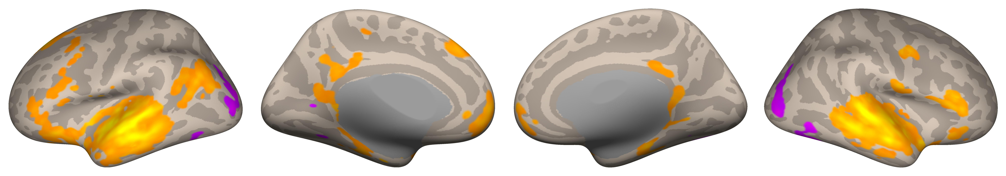

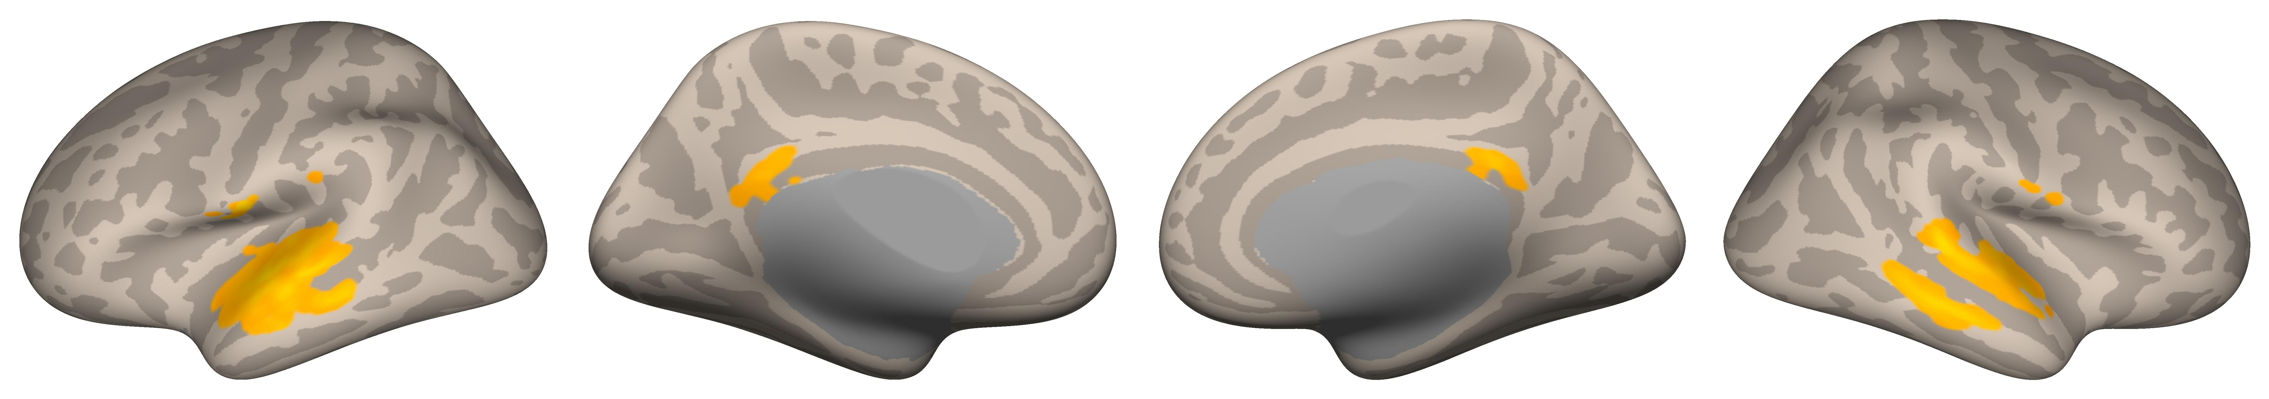
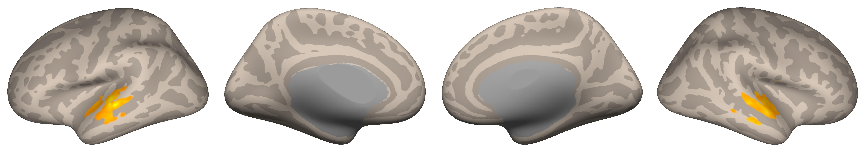
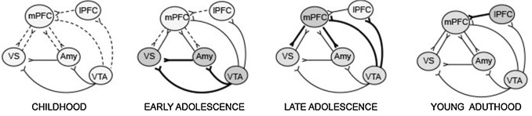
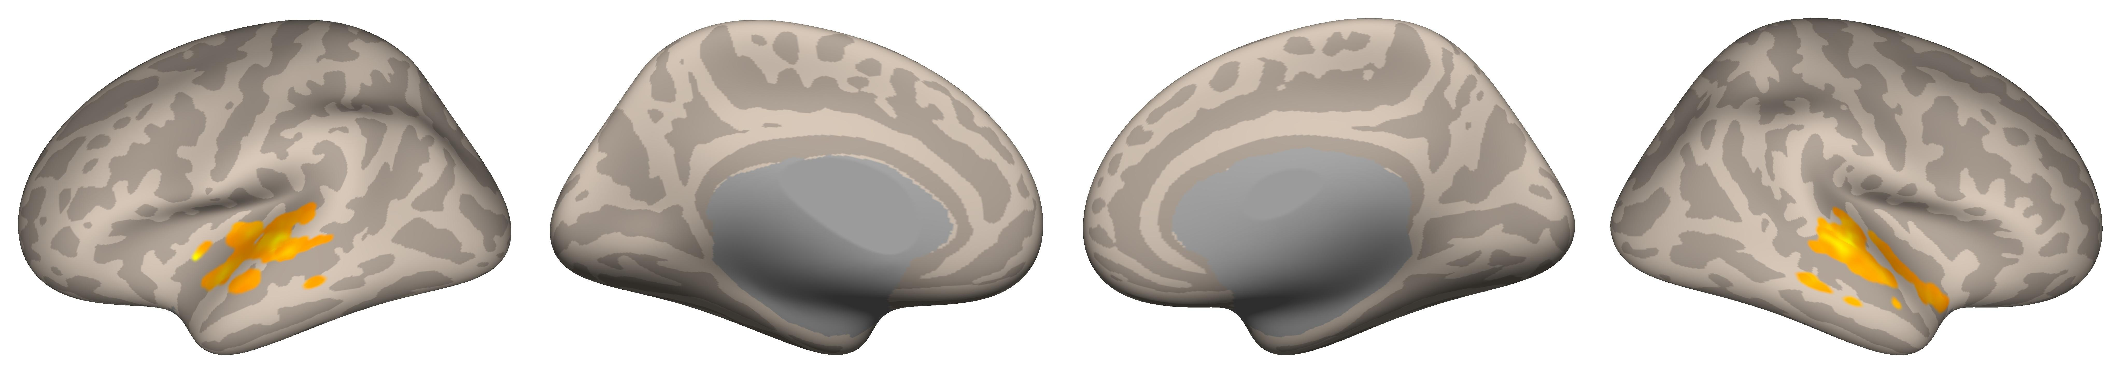
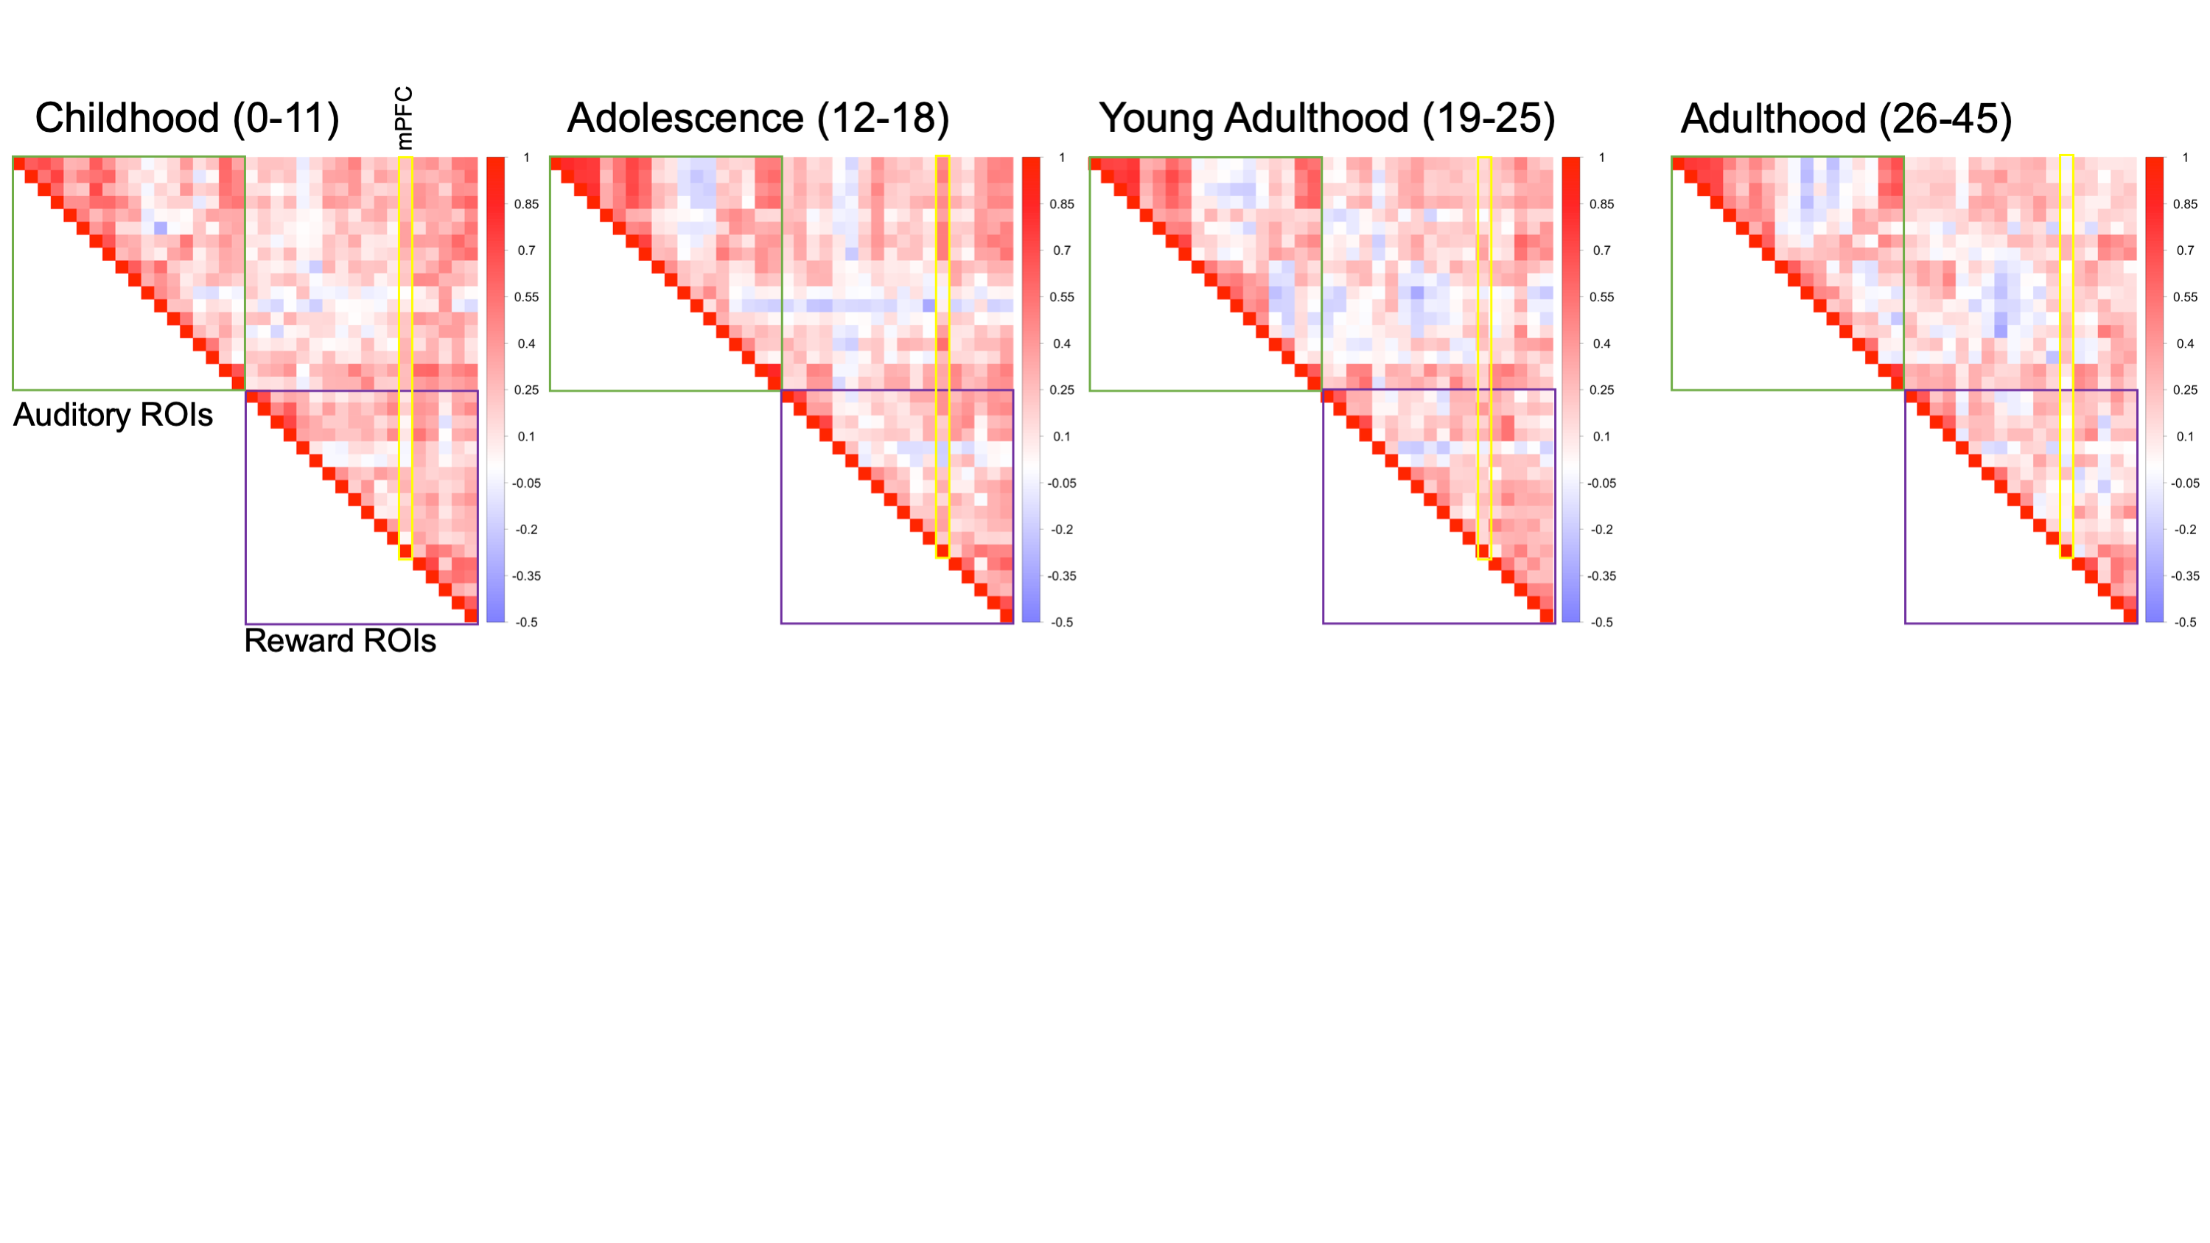
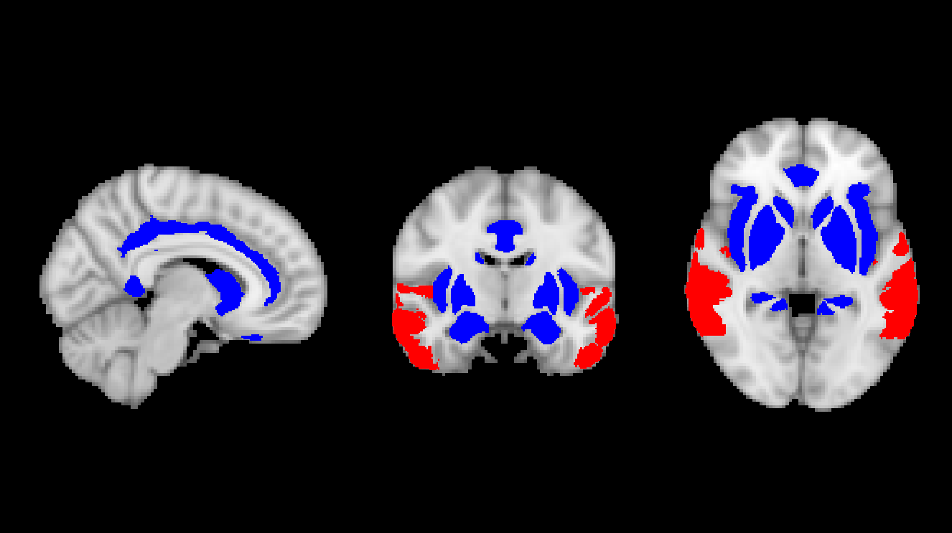
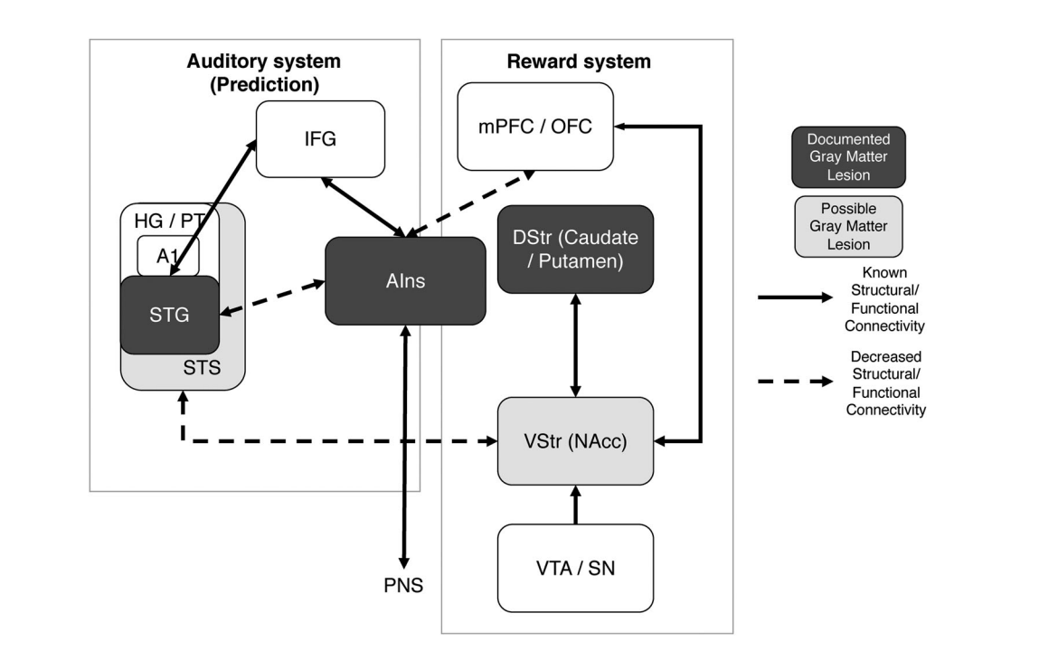
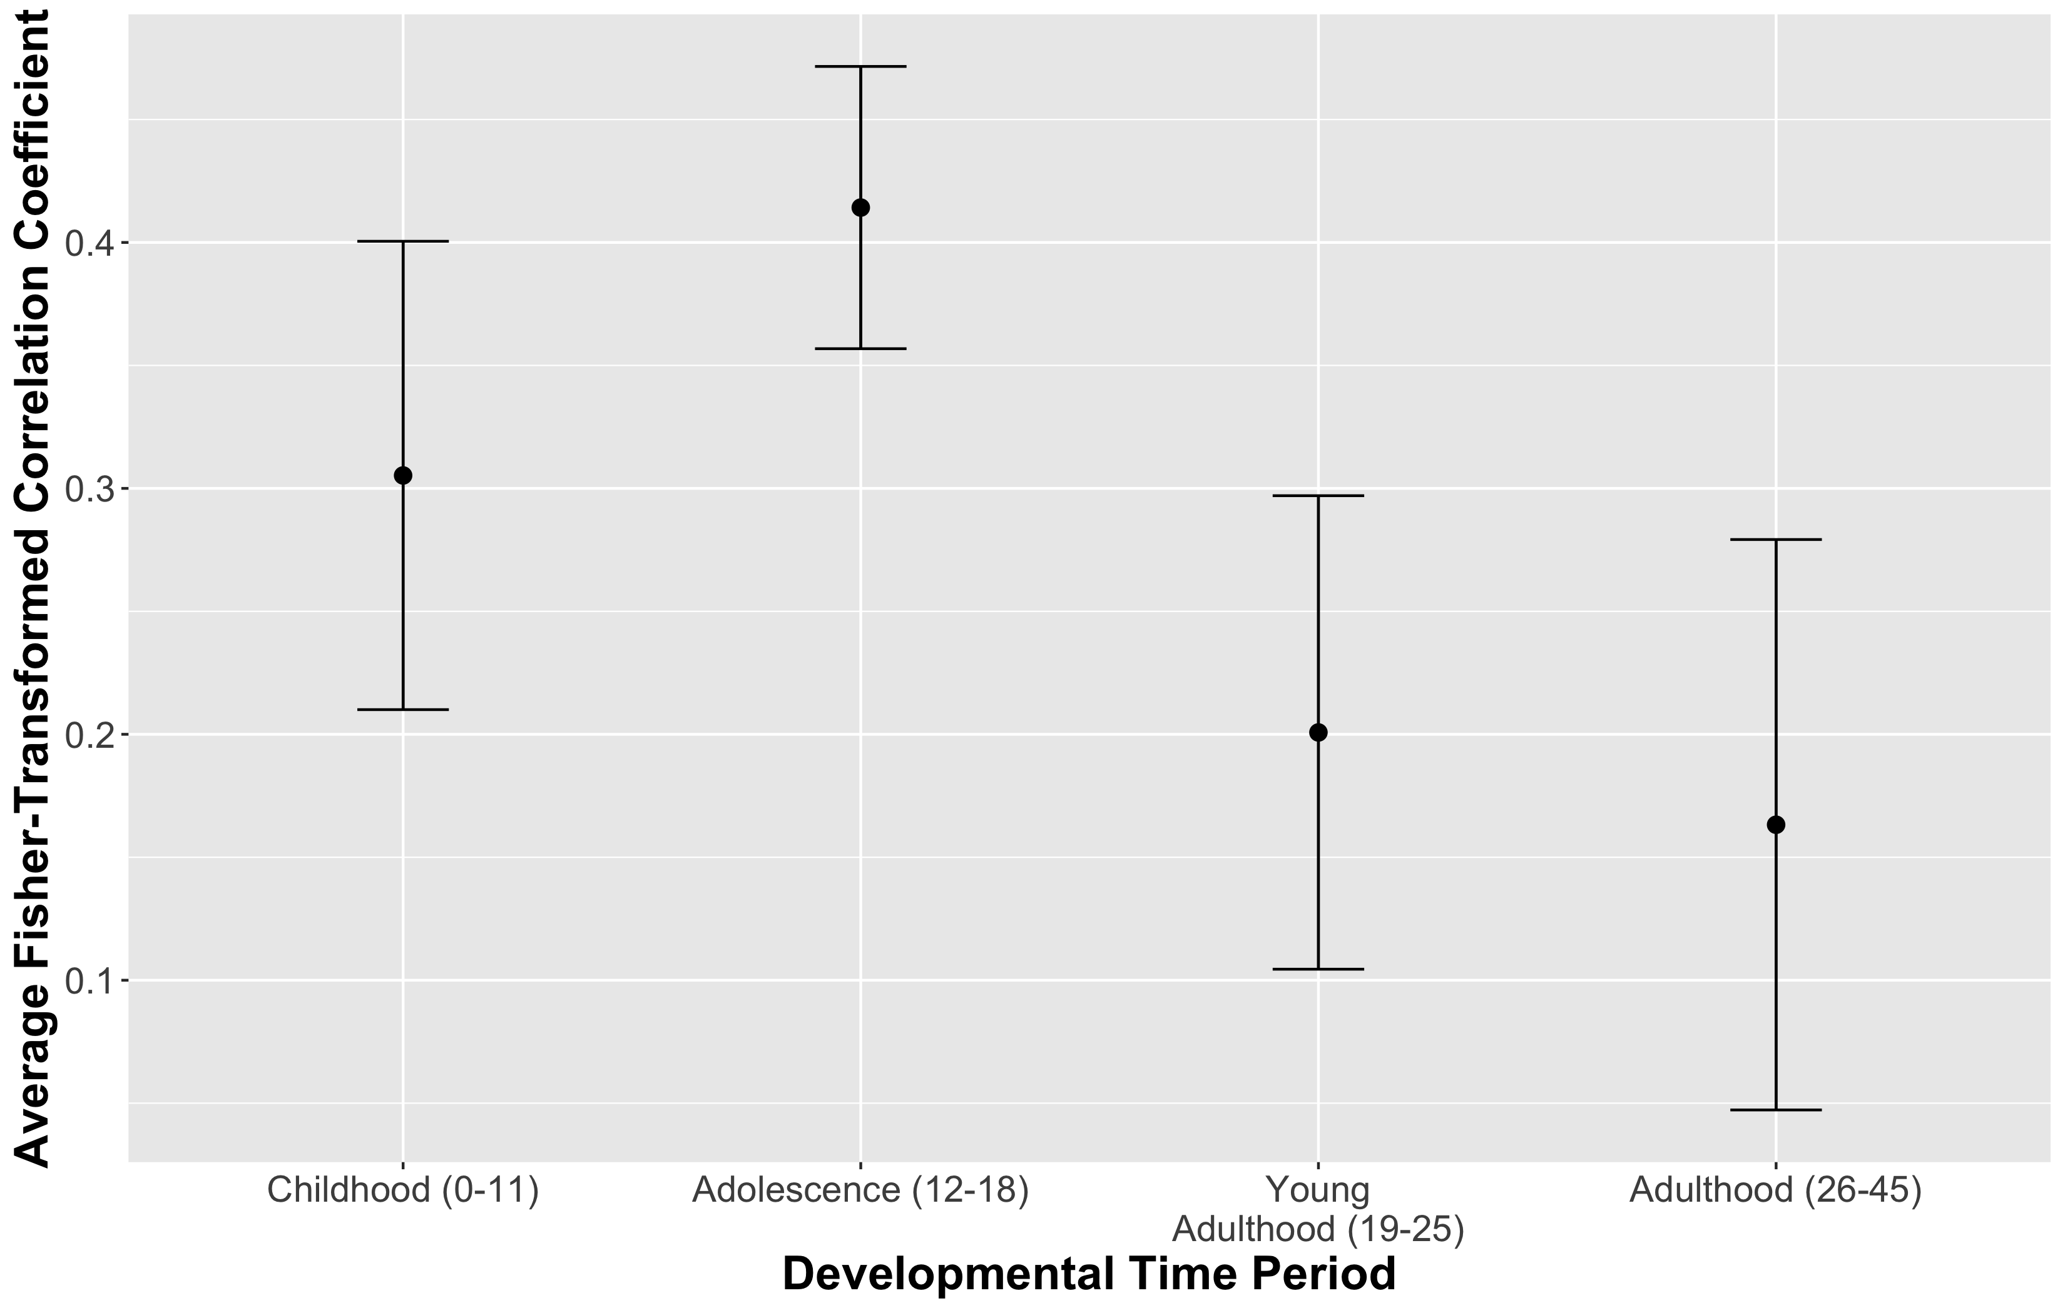

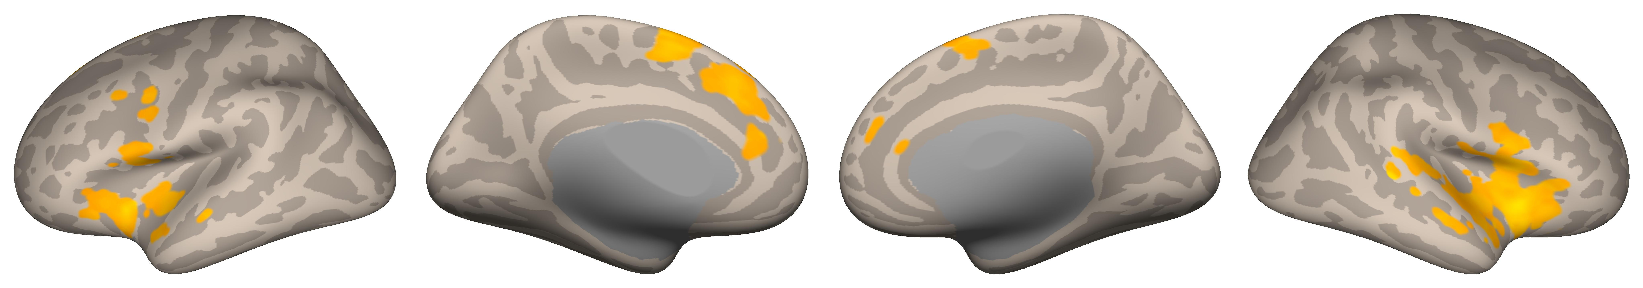
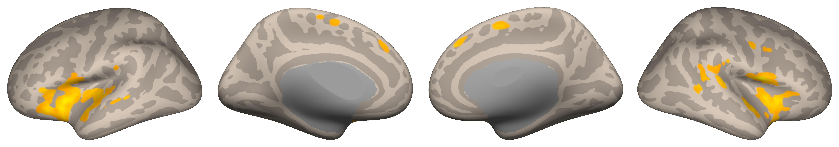

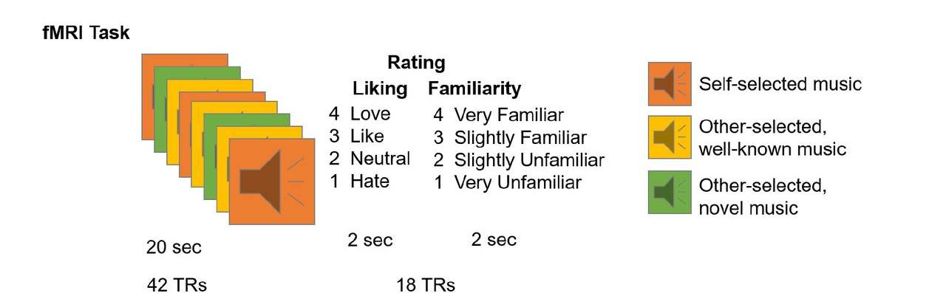

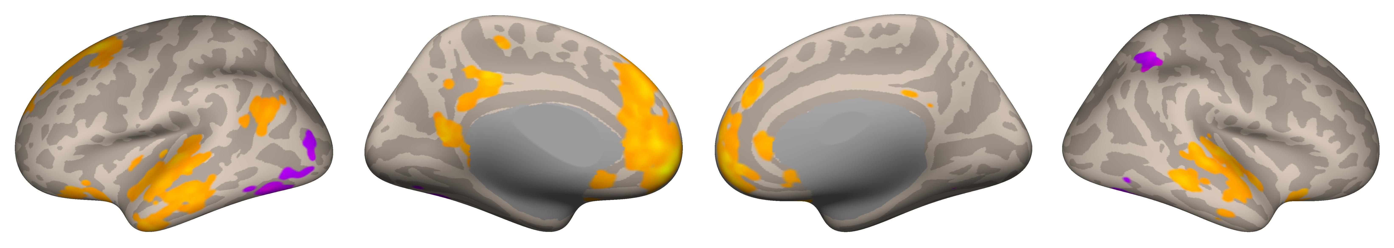



When You Heard it First: Age of Exposure Affects Functional
Connectivity between Auditory and Reward Networks
Nicholas Kathios¹, Milena Aiello Quinci¹, Psyche Loui¹
¹Northeastern University, Boston, MA
Background
Data Acquisition & Regions of Interest
Auditory Network Seed-Based Connectivity
Older adults tend to recall a disproportionately high number of autobiographical memories from their adolescence compared to any other time across the lifespan (the “reminiscence bump”)¹. For example, music first heard during adolescence, is often more preferred, more frequently recalled, and evokes more autobiographical memories, compared to music first heard during childhood or young adulthood.
Adolescents display relatively high sensitivity to reward, attributed to maturation of subcortical reward regions compared to regulatory prefrontal regions.^{2,3}
Pleasurable music listening experiences involves similar circuitry, as the anterior insula facilitates interactions between the auditory and reward systems.^{5,6}
Increased preference for music from one’s adolescence might, in part, reflect increased responsivity to & connectivity of reward and auditory regions that persists across the lifespan.
Hypothesis: Music first heard in listeners’ adolescence will show functional connectivity patterns that reflect this developmental trajectory
Data were preprocessed and analyzed using SPM12 (Statistical Parametric Mapping) software⁷ and the CONN Toolbox⁸. For seed to whole brain functional connectivity analyses, we seeded the mPFC as defined by the CONN toolbox, the anterior Insula⁹, and the Auditory Network⁶. For ROI-ROI connectivity analyses, we seeded the Reward and Auditory Networks⁶ along with the mPFC & anterior Insula.
Childhood (0-11)
mPFC
Anterior Insula
Adolescence (12-18)
Univariate Main Effect of Age of Exposure
Young Adulthood (19-25)
Adolescence (12-18)
Voxel & Cluster Thresholds: both p FDR-corrected <0.05
Music from adulthood (26-45) did not survive corrections.
Young Adulthood (19-25)
ROI-ROI Connectivity
Voxel Threshold: p FDR-corrected <0.05;
Cluster Threshold: p FDR-corrected <0.05
Music from childhood (0-11) and adulthood (26-45) did not survive corrections.
Anterior Insula Seed-Based Connectivity
Childhood (0-11)
Adolescence (12-18)
Methods
Discussion
18 cognitively healthy older adults (ages 54-89; M=66.6).
Ten participants completed a follow-up interview in which they reported when they thought they first heard familiar clips.
Clips were categorized based on timing of exposure: childhood (0-11), adolescence (12-18), young adulthood (19-25), and adulthood (26-45) using self-reports & Song-Specific Age (SSA).
fMRI data were acquired using a Siemens Magnetom 3T MR. Continuous acquisition was used for 1440 volumes with a fast TR of 475 ms. Forty-eight axial slices were acquired as echo-planar imaging (EPI) functional volumes covering the whole brain (voxel size = 3 mm³).
Voxel Threshold: p-FDR corrected <0.05;
Cluster Threshold: p FDR-corrected <0.05
Music from young adulthood (19-25) and adulthood (26-45) did not survive corrections.
Music encoded during adolescence differed in its functional connectivity patterns from that outside this time period, connecting the auditory network & Anterior Insula to reward regions (particularly the mPFC).
These preferences may reflect heightened sensitivity to reward-predictive cues in adolescence that persists across the lifespan.
Adolescent sensitivity to social reward may also account for these preferences, consistent with the Music for Social Bonding hypothesis.¹⁰
Future Directions: Cross-sectional & longitudinal music-listening fMRI studies; investigation of age-related differences on music reward-learning paradigms; SSA fMRI analyses in clinical populations.
Rubin, D. C., & Schulkind, M. D. (1997). The distribution of autobiographical memories across the lifespan. Memory & Cognition, 25(6), 859–866. https://doi.org/10.3758/BF03211330
Casey, B. J., Getz, S., & Galvan, A. (2008). The adolescent brain. Developmental Review, 28(1), 62–77. https://doi.org/10.1016/j.dr.2007.08.003
Steinberg, L., Albert, D., Cauffman, E., Banich, M., Graham, S., & Woolard, J. (2008). Age differences in sensation seeking and impulsivity as indexed by behavior and self-report: Evidence for a dual systems model. Developmental Psychology, 44(6), 1764–1778. http://dx.doi.org/10.1037/a0012955
Casey, B., Galván, A., & Somerville, L. H. (2016). Beyond simple models of adolescence to an integrated circuit-based account: A commentary. Developmental Cognitive Neuroscience, 17, 128–130. https://doi.org/10.1016/j.dcn.2015.12.006
Belfi, A. M., & Loui, P. (2020). Musical anhedonia and rewards of music listening: Current advances and a proposed model. Annals of the New York Academy of Sciences, 1464(1), 99–114. https://doi.org/10.1111/nyas.14241
Wang, D., Belden, A., Hanser, S. B., Geddes, M. R., & Loui, P. (2020). Resting-State Connectivity of Auditory and Reward Systems in Alzheimer’s Disease and Mild Cognitive Impairment. Frontiers in Human Neuroscience, 14. https://www.frontiersin.org/article/10.3389/fnhum.2020.00280
Penny, W. D., Friston, K. J., Ashburner, J. T., Kiebel, S. J., & Nichols, T. E. (2011). Statistical Parametric Mapping: The Analysis of Functional Brain Images. Elsevier.
Whitfield-Gabrieli, S., & Nieto-Castanon, A. (2012). Conn: A Functional Connectivity Toolbox for Correlated and Anticorrelated Brain Networks. Brain Connectivity, 2(3), 125–141. https://doi.org/10.1089/brain.2012.0073
Deen, B., Pitskel, N. B., & Pelphrey, K. A. (2011). Three Systems of Insular Functional Connectivity Identified with Cluster Analysis. Cerebral Cortex, 21(7), 1498–1506. https://doi.org/10.1093/cercor/bhq186
Savage, P. E., Loui, P., Tarr, B., Schachner, A., Glowacki, L., Mithen, S., & Fitch, W. T. (2021). Music as a coevolved system for social bonding. Behavioral and Brain Sciences, 44. https://doi.org/10.1017/S0140525X20000333
We acknowledge support from NIH R21AG075232, Grammy Foundation, NSF-CAREER 1945436, NSF-STTR 2014870, and Kim and Glenn Campbell Foundation.
Childhood
Adolescence
mPFC Seed-Based Connectivity
Adolescence (12-18)
References
Voxel Threshold: p FDR-corrected <0.05;
Cluster Threshold: p FDR-corrected <0.05
Music from childhood (0-11), young adulthood (19-26), and adulthood (26-45) did not survive corrections.
kathios.n@northeastern.edu
@nickkathios
Notes:
This poster was inspired by the “reminiscence bump” effect, or the tendency of older adults to be able to recall a disproportionately high amount of autobiographical memories from their adolescence & young adulthood compared to any other time across the lifespan.
In fact, neurodevelopment in adolescence seems to support this suggestion, as adolescence is a time in which individuals are highly sensitive to rewards. This sensitivity has been attributed to the rapid maturation of subcortical reward regions during this time, and circuit-based models suggest that regulatory prefrontal connections to the reward system develop throughout adolescence.
Importantly, these regions & connections are quite important in pleasurable music experiences, which involve interactions between the auditory system + reward regions, facilitated by the anterior insula
Older adults display lifelong preferences for music from their adolescence, suggesting age of exposure to music plays a role in establishing these preferences.
I then divided each clip based on how old the participant was when they first heard the music from that block
We found adolescent music elicited connectivity from the anterior insula to the ventral striatum, as predicted by adolescent developmental trajectories & neuroanatomical models of rewarding music experiences.
Overall, this suggests that age of encoding impacts functional connectivity patterns while listening to music, perhaps underlying this behavioral preference for music from adolescence

